Slide 1
Data Science Curricula at the University of Washington
Bill Howe, PhD
Director of Research, Scalable Data Analytics
University of Washington eScience Institute

Slide 2



Slide 3
http://escience.washington.edu

Slide 4
The University of Washington eScience Institute
Rationale
The exponential increase in sensors is transitioning all fields of science and engineering from data-poor to data-rich
Techniques and technologies include
Sensors and sensor networks, databases, data mining, machine learning, visualization, cluster/cloud computing
If these techniques and technologies are not widely available and widely practiced, UW will cease to be competitive
Mission
Help position the University of Washington at the forefront of research both in modern eScience techniques and technologies, and in the fields that depend upon them
Strategy
Bootstrap a cadre of Research Scientists
Add faculty in key fields
Build out a “consultancy” of students and non-research staff
Notes:
In all fields of science, data is starting to come in faster than it can be analyzed, so we need to advance and proliferate computational technologies in sensor networking, databases and data mining, visualization, machine learning, and cluster/cloud computing.
And if we don’t, we see UW losing its competitive edge.
The mission of the eScience Institute is to prevent that from happening
So by the animation loophole, there we go.
Funding! We have $1M from the state, and we just got a nice award from the Moore foundation, and several proposals outstandind.
People! We have a fantastic team: Dave Beck in Biosciences, Jeff Gardner in Astrophysics and HPC, myself in Databases, Ed and Erik, Mette Peters in Health Sciences, and Chance Reshke in large-scale computing platforms.
And there’s our URL: escience.washington

Slide 5
eScience Big Data Group
Bill Howe, Phd (databases, cloud, data-intensive scalable computing, visualization)
Staff
Seung-Hee Bae, Phd (postdoc, scalable machine learning algorithms)
Dan Halperin, Phd (postdoc; scalable systems)
Sagar Chitnis, Research Engineer (Azure, databases, web services)
(alumna) Marianne Shaw, Phd (hadoop, semantic graph databases)
(alumna) Alicia Key, Research Engineer (visualization, web applications)
Students
Scott Moe (2nd yr Phd, Applied Math)
Daniel Perry (2nd yr Phd, HCDE)
Partners
CSE DB Faculty: Magda Balazinska, Dan Suciu
CSE students: Paris Koutris, Prasang Upadhyaya,
UW-IT (web applications, QA/support)
Cecilia Aragon, Phd, Associate Professor, HCDE (visualization, scientific applications)

Slide 6
A Taxonomy of Data Science Curricula

Slide 7
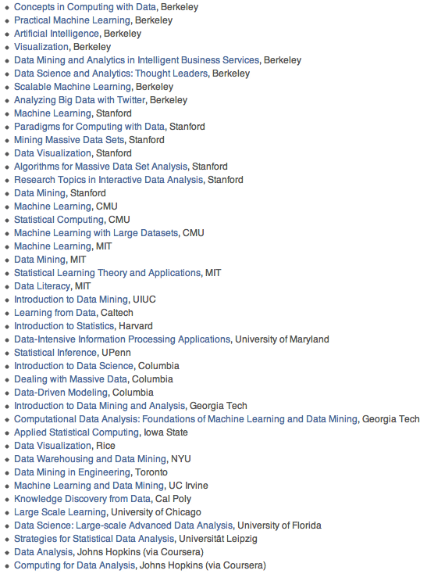
Huge number of relevant courses, new and existing.

Slide 8
tools abstractions
Breadth
Notes:
R data frames or matrices?
Hadoop or MapReduce?
Greenplum or Relational Algebra?

Slide 9
structures statistics
Depth
Relational Algebra
Linear Algebra
Notes:
How much statistical sophistcation do you emphasize?
Select, project, join
slicing and dicing tables
key value stores
vs
Linear algebra
EM
Gradient descent
Statistical pattern recognition
Unsupervised learning

Slide 10
desktop cloud
Scale
Notes:
Using R to analyze survey results
Using Hadoop to analyze clickstream

Slide 11
hackers analysts
Target
Notes:
How much programming background do you assume? How much do you teach?

Slide 12
Breadth
tools
abstr.
Depth
structs
stats
Scale
desk
cloud
Target
hackers
analysts

Slide 13
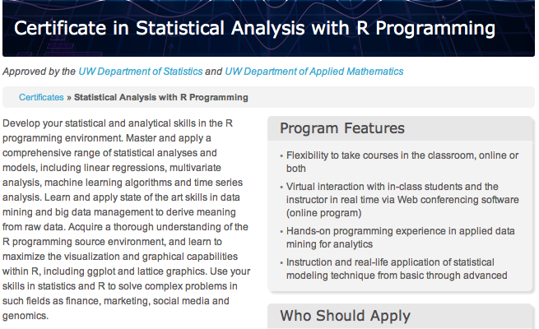
tools
abstr.
structs
stats
desk
cloud
hackers
analysts

Slide 14


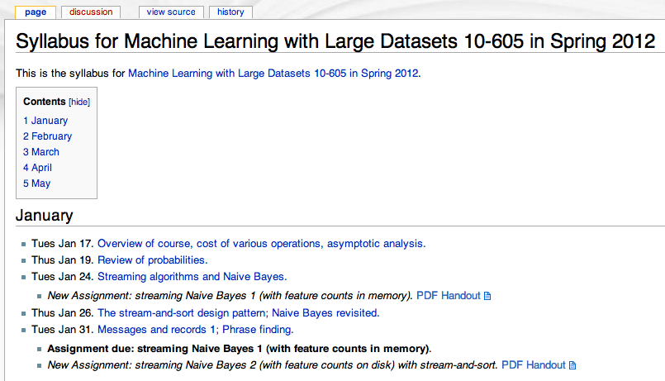
William W. Cohen
Machine Learning
tools
abstr.
tools
abstr.
structs
stats
structs
stats
desk
cloud
desk
cloud
hackers
analysts
hackers
analysts

Slide 15

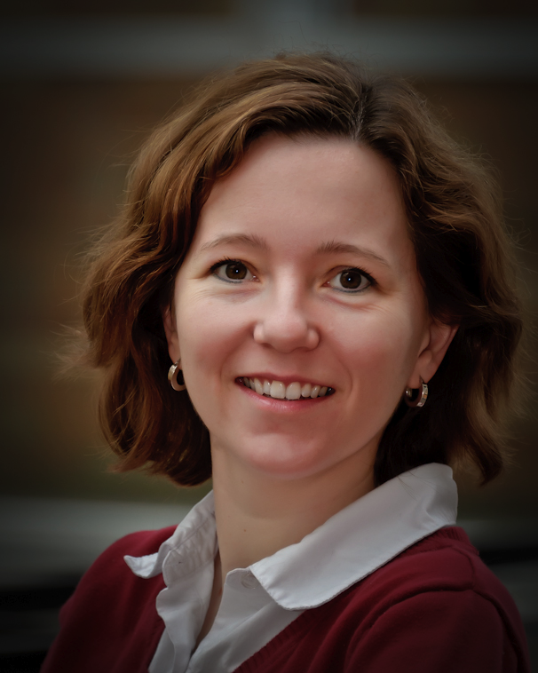
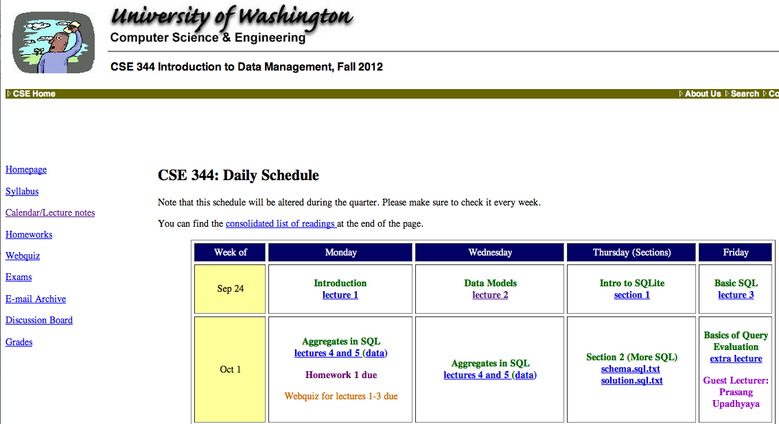
Dan Suciu
Magda Balazinska
tools
abstr.
CSE 344 Introduction to Data Management
structs
stats
desk
cloud
hackers
analysts

Slide 16
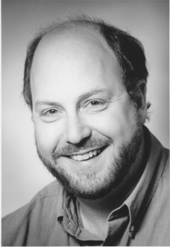
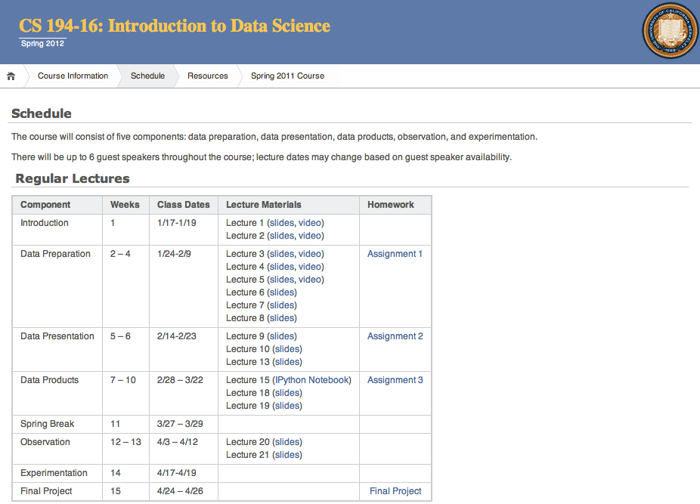
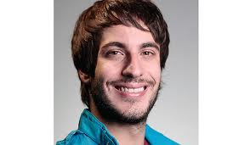
Jeff Hammerbacher
Mike Franklin
tools
abstr.
structs
stats
desk
cloud
hackers
analysts

Slide 17


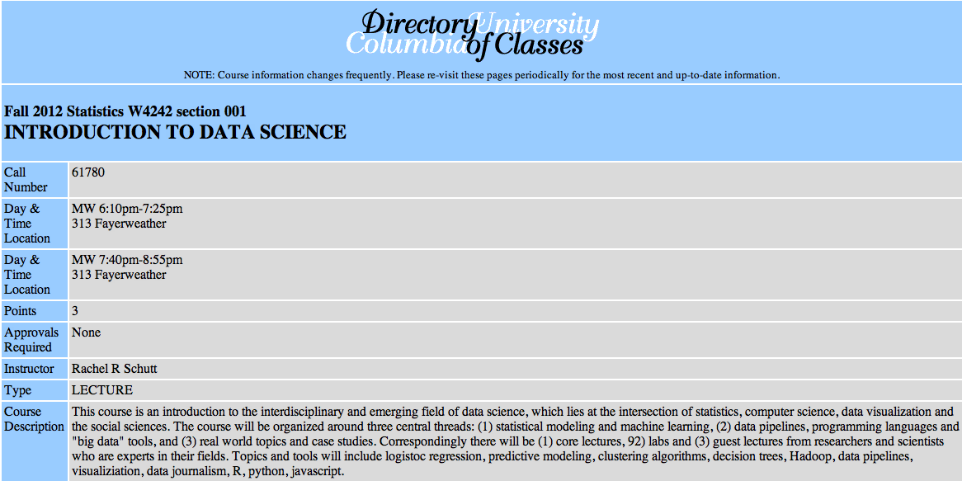
Introduction to Data Science
Rachel Schutt
tools
abstr.
structs
stats
desk
cloud
hackers
analysts

Slide 18

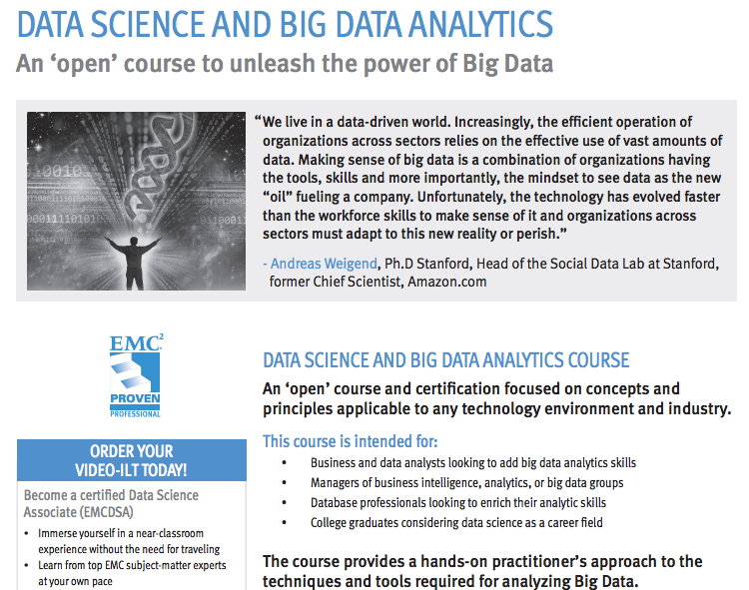
tools
abstr.
structs
stats
desk
cloud
hackers
analysts

Slide 19

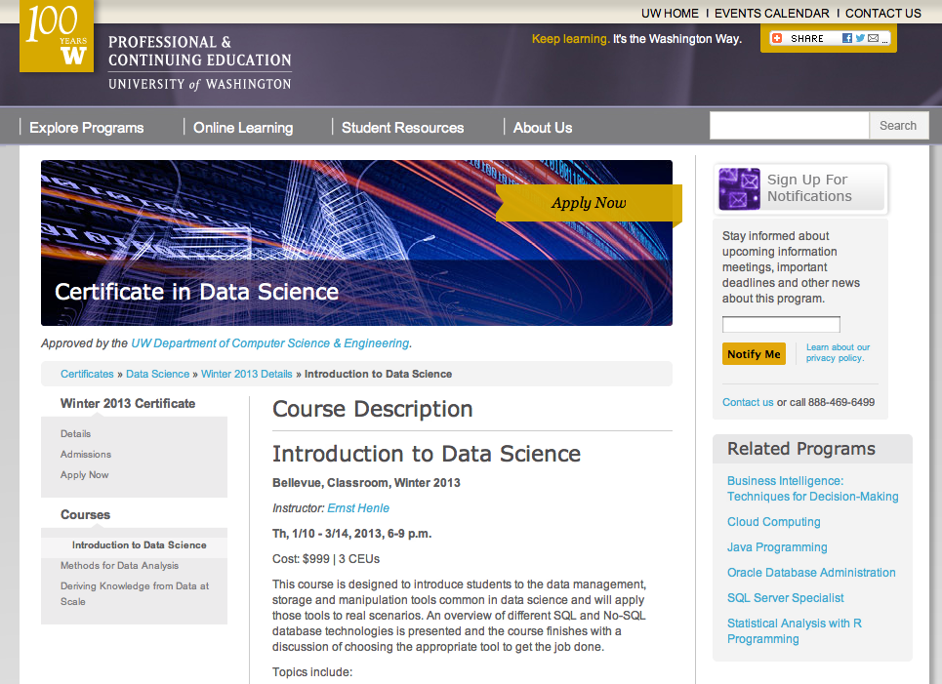
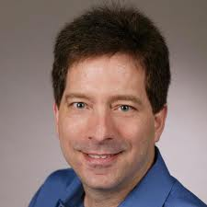
Bill Howe
Richard Sharp
Roger Barga
tools
abstr.
structs
stats
desk
cloud
hackers
analysts

Slide 20
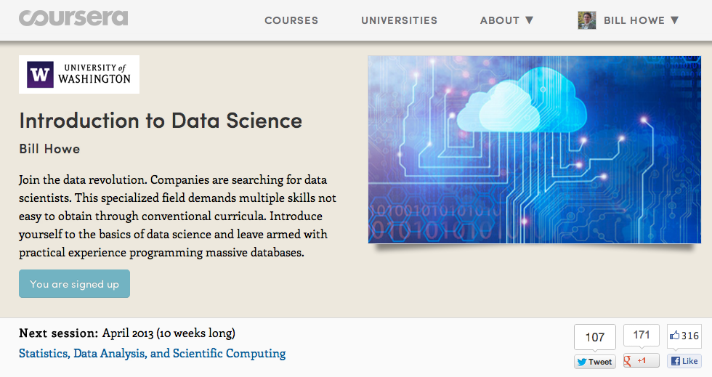
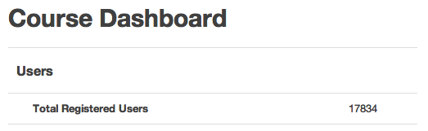
Bill Howe
tools
abstr.
structs
stats
desk
cloud
hackers
analysts

Slide 21
tools
abstr.
structs
stats
desk
cloud
hackers
analysts

Slide 22
What goes around comes around
tools
abstr.
2004 Dean et al. MapReduce
2008 Hadoop 0.17 release
2008 Olston et al. Pig: Relational Algebra on Hadoop
2008 DryadLINQ: Relational Algebra in a Hadoop-like system
2009 Thusoo et al. HIVE: SQL on Hadoop
2009 Hbase: Indexing for Hadoop
2010 Dietrich et al. Schemas and Indexing for Hadoop
2012 ACID Transactions for Hadoop
But also some permanent contributions:
Fault tolerance
Schema-on-Read
User-defined functions that don’t suck

Slide 23
tools
abstr.
What are the abstractions of data science?
matrices and linear algebra -> statistics
relations and relational algebra -> databases
objects and methods -> Java
files and message passing -> HPC
data frames and functions -> R
Notes:
matrices and linear algebra -> statistics
relations and relational algebra -> databases
files and message passing -> HPC
data frames and functions -> R

Slide 24
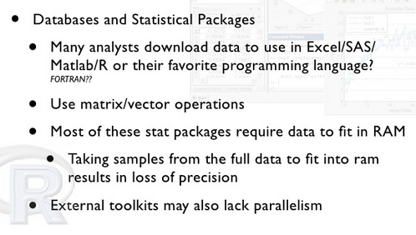
tools
abstr.
src: Christian Grant, MADSkills

Slide 25
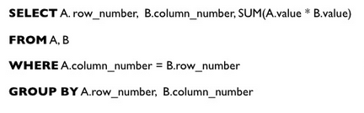
(Sparse) Matrix Multiply in SQL
tools
abstr.
src: Christian Grant, MADSkills

Slide 26
structs
stats
“80% of analytics is sums and averages”
-- Aaron Kimball, wibidata
God created the integers; all else is the work of man
Codd created relations; all else is the work of man
Notes:
R and files vs. databases
Hadoop and friends vs. databases
God created …. Codd created….

Slide 27
Three types of tasks:
stats
structs
1) Preparing to run a model
2) Running the model
3) Interpreting the results
“80% of the work”
-- Aaron Kimball
Gathering, cleaning, integrating, restructuring, transforming, loading, filtering, deleting, combining, merging, verifying, extracting, shaping, massaging
The other 80% of the work

Slide 28
Problem
structs
stats
How much time do you spend “handling data” as opposed to “doing science”?
Mode answer:
“90%”
Notes:
(granted we had a minute for Bill (clearly Bill) to describe this new eScience movement)
We want to give a little background of our project before we launch into it, so we will discuss the problem we are trying to solve.
Essentially, we want to remove the speed-bump of data handling from the scientists.

Slide 29
hackers
analysts
US faces shortage of 140,000 to 190,000 people “with deep analytical skills, as well as 1.5 million managers and analysts with the know-how to use the analysis of big data to make effective decisions.”
Mckinsey Global Institute

Slide 30
UW Curricular Activities
 | Students |  |  |  | Non-Students
 | CS/Informatics |  | Non-Major |  | professionals | researchers
 | undergrads | grads | undergrads | grads
UWEO Data Science Certificate
Graduate Certificate in Big Data
Database Courses
eScience workshops
Intro to data programming
eScience Masters (planned)
Coursera Course Intro to Data Science

Slide 31
10k Students on 10k GB for $10k
Requirements
Inexpensive: Need a fixed, small budget; O(10k) maximum
Fair: All students need to be able to complete the assignment
Non-solutions
Fixed cluster
Fairness problems; no quality of service guarantees
Autoscaling cluster
No upper bound to cost
Budget cap (via, e.g., Amazon’s IAM)
Fairness problems: Different students consume different levels of resources depending on background, etc.

Slide 32
10k Students on 10k GB for $10k
Key idea: 10k students all working on the same assignment = lots of redundancy
Students debug locally on scaled down datasets
Then submit 10k jobs
Prune the queue aggressively
Remove duplicates
Detect typical mistakes syntactically; return cached results
Global common subexpression elimination (feasible thanks to abstractions)

Slide 33
10k Students on 10k GB for $10k
Another approach we are considering: Kaggle-Kaggle-style Prize assignments
student | date | runtime | output | quality | notes | votes
sarah123 | 4/23/12 | 5 min 44 sec | result.txt | 45% | I removed the dirty data for this run | 456
jane456 | 4/22/12 | 3 min 23 sec | result.txt | 23% | I used gradient descent this time | 97
:
:
Pay-to-play: Students submit successful jobs to access leaderboards
Cast votes for their preferred solution.
Grade determined by
f(votes(your_solution), grade(your_solution), grade(solutions_you_voted_for))
We run the top-k highest ranked solutions on the full size dataset
Problem: Easy to game the system and just coast

Slide 34
Data Science Cohorts
Professionals
Non-CSE students
CSE students
Researchers
grad students, postdocs, staff, faculty

Slide 35
Comparison
 | Data Model | Prog. Model | Services
GPL | * | * | Typing (maybe)
Workflow | * | dataflow | typing, provenance, scheduling, caching, task parallelism, reuse
Relational Algebra | Relations | Select, Project, Join, Aggregate, … | optimization, physical data independence, data parallelism
MapReduce | [(key,value)] | Map, Reduce | massive data parallelism, fault tolerance
MS Dryad | IQueryable, IEnumerable | RA + Apply + Partitioning | typing, massive data parallelism, fault tolerance
MPI | Arrays/ Matrices | 70+ ops | data parallelism, full control

Slide 36
eScience is Data Science
…applied to basic research
Notes:
used to draw a distinction between scientific data management and business data management: no more
business:
-- collect it wantonly (clickstreams from a website)
-- reuse it for purposes other than for which it was collected
-- hypothesis-based analysis
Both areas shifting: data acquisition activities decoupled from any specific hypothesis
Quants on Wall Street
Next generation of data scientists will not necessarily be computer science majors
Aaron Kimball: “Would you consider training a physics major to do data science?” “We already hire them”

Slide 37
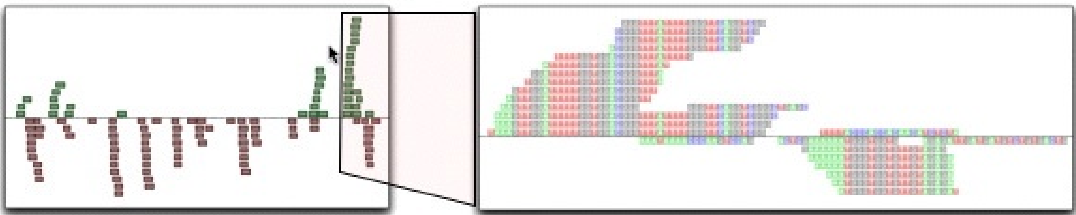
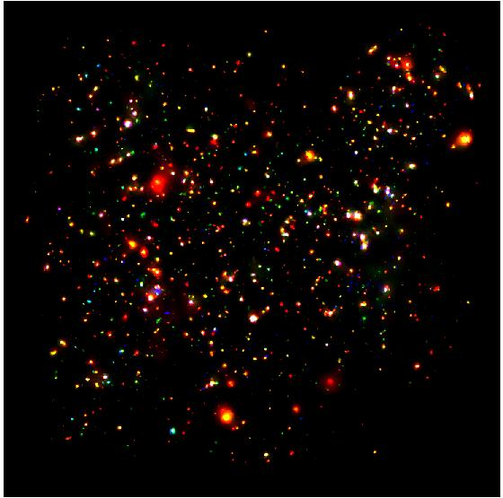
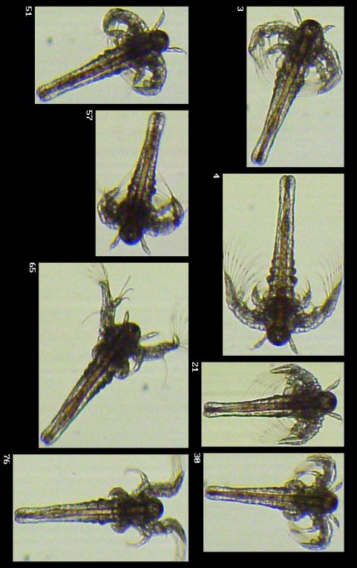
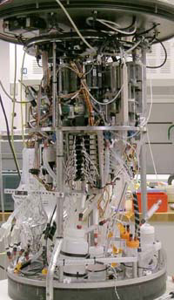
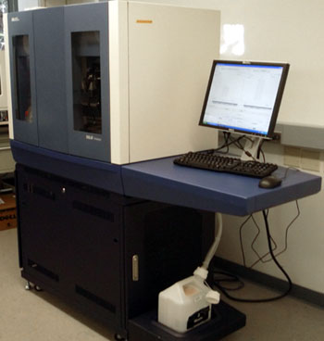

Science is becoming a database query problem
Old model: “Query the world” (Data acquisition coupled to a specific hypothesis)
New model: “Download the world” (Data acquisition supports many hypotheses)
Astronomy: High-resolution, high-frequency sky surveys (SDSS, LSST, PanSTARRS)
Biology: lab automation, high-throughput sequencing,
Oceanography: high-resolution models, cheap sensors, satellites
40TB / 2 nights
1 device
~1TB / day
100s of devices
Notes:
Drowning in data; starving for information
We’re at war with these engineering companies. FlowCAM is bragging about the amount of data they can spray out of their device. How to use this enormous data stream to answer scientific questions is someone else’s problem.
“Typical large pharmas today are generating 20 terabytes of data daily. That’s probably going up to 100 terabytes per day in the next year or so.”
“tens of terabytes of data per day” -- genome center at Washignton University
Increase data collection exponentially with flowcam

Slide 38
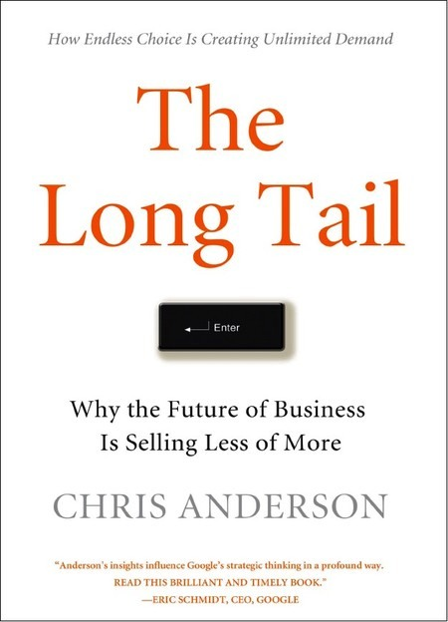
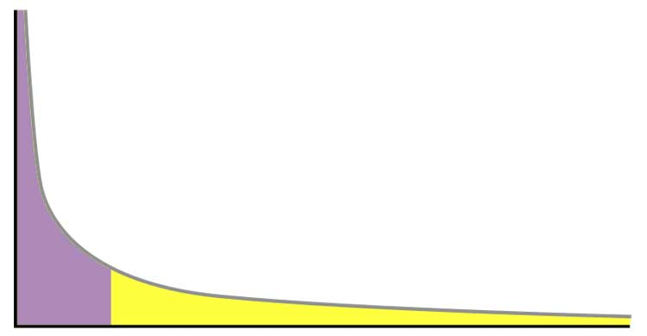
[src: Carol Goble]
Power distribution
80:20 rule
Head
Popularity / Sales
Tail
Products / Results
First published May 2007, Wired Magazine article 2004
Notes:
80:20 rule
Power laws
The Long Tail or long tail refers to the statistical property that a larger share of population rests within the tail of a probability distribution than observed under a 'normal' or Gaussian distribution.
Small Science
New Science
Open Science
Distributed Science
Niche Science

Slide 39
Sample Programs
CAS in Data Science
Syracuse
iSchool
This is the first New York State approved certificate of advanced study in Data Science
specialization of data analytics, data storage & management, data visualization or general systems management.
Masters in Analytics
Northwestern
Industrial Engineering and Management Sciences

Slide 40
Courses
too many to list
Introduction to Data Science
Columbia
http://www.columbia.edu/cu/bulletin/uwb/subj/STAT/W4242-20123-001/
Introduction to Data Science
Berkeley CS
Jeff Hammerbacher and Mike Franklin
Data Science and Analytics Thought Leaders
http://courses.ischool.berkeley.edu/i296a-dsa/s12/

Slide 41
UWEO Certificate
eScience Masters Program (planned)
Big Data Graduate Certificate
Introduction to Data Programming
eScience Masters Degree
Data Science Coursera Course

Slide 42
Data Science Certificate Program
UW Educational Outreach
RSVP's for an information session that was scheduled in August reached its 175 capacity the same week it was announced.
One of the earliest Certificate programs to fill during the fall 2012 recruiting season.

Slide 43
Data Science Certificate Program
Three courses
Introduction to Data Science
Structural manipulation at scale
Methods for Data Analysis
ML and analytics
Deriving Knowledge from Data at Scale
Synthesis and Applications

Slide 44
Intro to Data Science
cloud
Deriving Knowledge from Data at Scale
Methods for Data Analysis
desktop
structural
statistical

Slide 45

cloud
UWEO Data Science Certificate
CSE database courses
Introduction to Data Science
desktop
CSE ML courses
structural
statistical

Slide 46
How do you deliver hands-on big data experience to 10k students?
Cloud vendors’ free tiers?
1 micro instance is not “big data”
Cloud vendors’ academic discounts? (e.g., Amazon’s education grants)
$100 / head = $1M
invites abuse: free credits with no obligation to complete course
Out of pocket?
Don’t want to be the only non-free Coursera course
Unclear that we can require it (perhaps analogous to a textbook?)

Slide 47
Berkeley
CS 194-16: Introduction to Data Science
Instructors
Jeff Hammerbacher and Mike Franklin
Prerequisites
Data manipulation: Python, R, databases
Web Programming: HTML, CSS, and JavaScript
Probability and Statistics

Slide 48
Learning Objectives
Explain the major trends in technology, business, and science behind the terms “data science” and “big data.”
Explain the relative strengths and weaknesses of a “spanning basis” of data analytics platforms available.
Analyze application requirements Design an application architecture for scalable data analytics.
Explain the major technology trends that are influencing the industry.

Slide 49
Detecting influenza epidemics using search engine query data
Jeremy Ginsberg1, Matthew H. Mohebbi1, Rajan S. Patel1, Lynnette Brammer2, Mark S. Smolinski1 & Larry Brilliant1
Google Inc., 1600 Amphitheatre Parkway, Mountain View, California 94043, USA
Centers for Disease Control and Prevention, 1600 Clifton Road, NE, Atlanta, Georgia 30333, USA

Slide 50
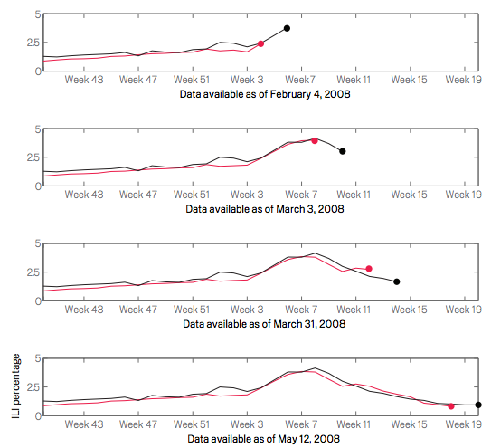

Slide 51
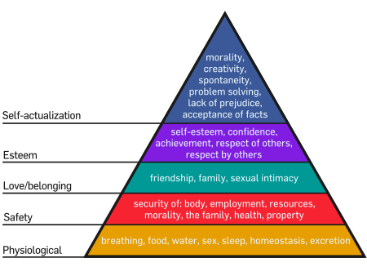
A “Needs Hierarchy” of Science Data Management
“As each need is satisfied, the next higher level in the hierarchy dominates conscious functioning.”
-- Maslow 43
full semantic integration
analytics
query
sharing
storage
Notes:
But the fundamental error made by computer scientists, and it’s probably the fault of the database community, is to assume that semantic integration is a prerequisite for query and analytics.
It isn’t. It’s the final goal, not some insignificant preamble to analysis.
Domain scientists know this – they take a very pragmatic approach. They write code to do data handling, they write code to do analytics, and they do data integration on the fly in a task-specific way.
So one of my goals is to convince you of is that you can decouple declarative query from semantic integration, and doing so gives scientists a very powerful tool.

Slide 52
[src: Carol Goble]
Power distribution
80:20 rule
Head
Popularity / Sales
Tail
Products / Results
First published May 2007, Wired Magazine article 2004
Notes:
80:20 rule
Power laws
The Long Tail or long tail refers to the statistical property that a larger share of population rests within the tail of a probability distribution than observed under a 'normal' or Gaussian distribution.
Small Science
New Science
Open Science
Distributed Science
Niche Science

Slide 53

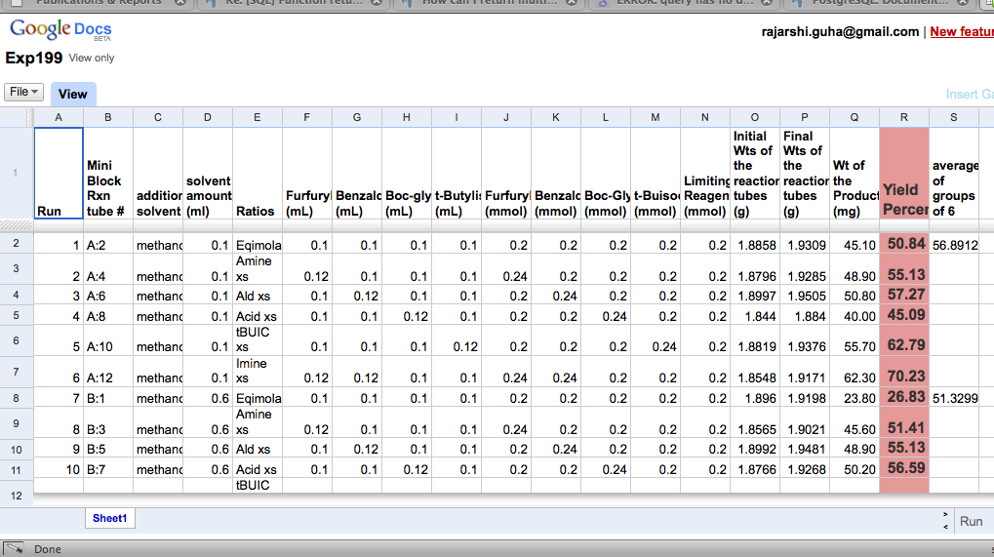
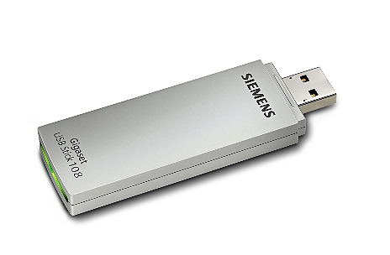
Long Tail of Research Data
[src: Carol Goble]
High throughput experimental methods
Industrial scale
Commons based production
Publicly data sets
Cherry picked results
Preserved
GenBank
PDB
UniProt
ChemSpider
Pfam
CATH, SCOP
(Protein Structure Classification)
Spreadsheets, Notebooks
Local, Lost
Notes:
CATH database (http://www.cathdb.info/). Its about protein structure classification, so it is quite niche.
SCOP (http://scop.mrc-lmb.cam.ac.uk/scop), the other protein structure classification database. Its information is manually curated by Alexey Murzin and his group at the MRC Laboratory of Molecular Biology in Cambridge. Its web page still looks like it belongs in the late 90s.
ChemSpider was originally a homemade project but was bought out by the Royal Society of Chemistry when they realised what a valuable resource it was to chemists.
Massive centralisation – clouds and curated core facilities Massive decentralisation – sticks, spreadsheets, wikis

